Slide 1

www.olms.dol.gov
LM-10 Electronic Form
Requirements Review
OLMS – EFS LM 10

Slide 2
www.olms.dol.gov
OVERVIEW
Registration Process
Page Level Design/Requirements & Validation Rules
Signature
Questions
OLMS – EFS LM 10

Slide 3
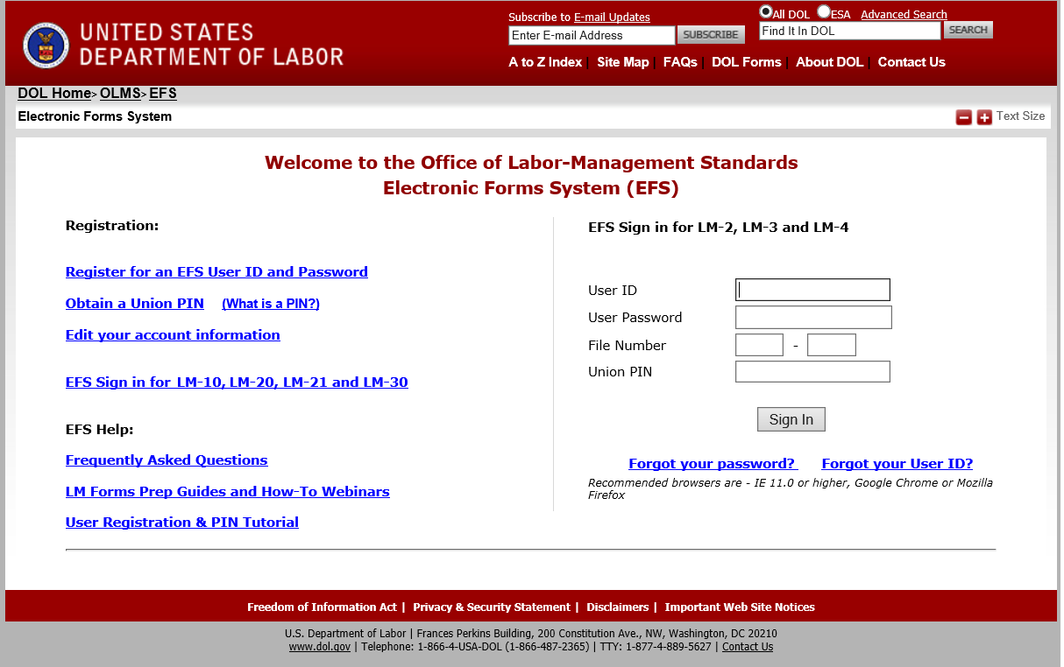
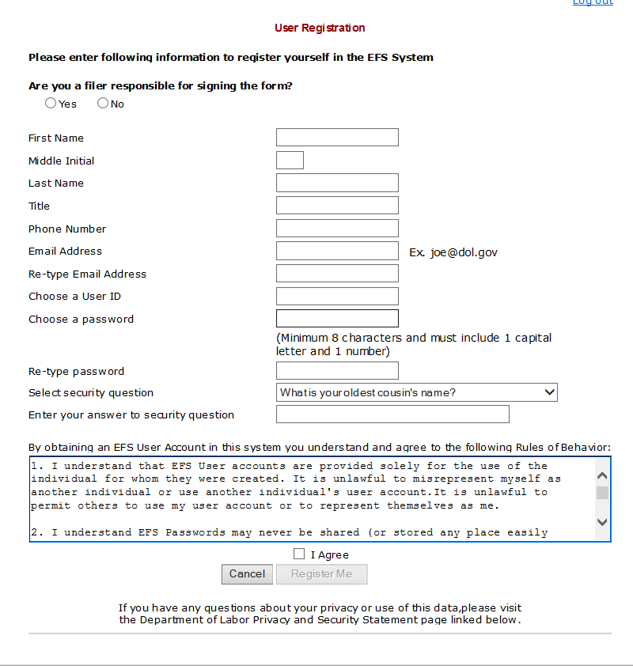
www.olms.dol.gov
EFS User Registration Process
OLMS - EFS LM 10
Filer/Preparer will register for an EFS account
Once the EFS account is created, the Filer will register the reporting organization

Slide 4
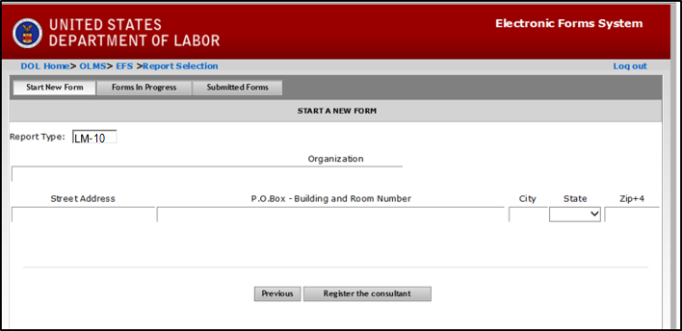
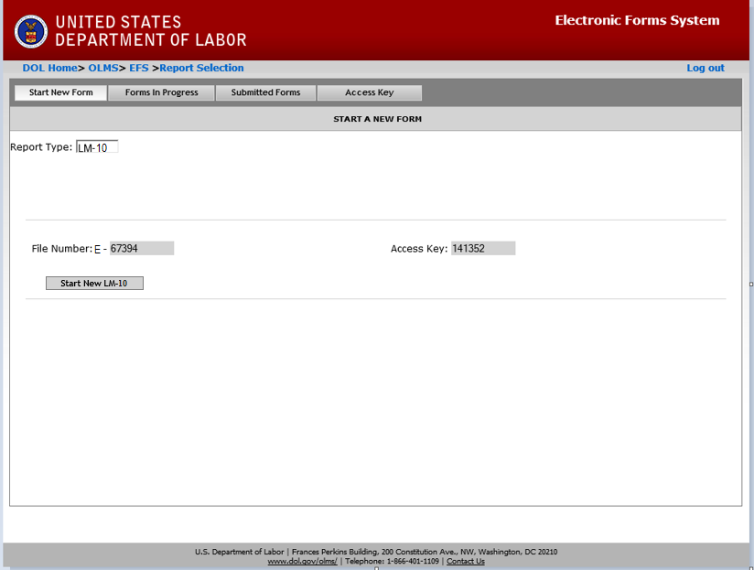
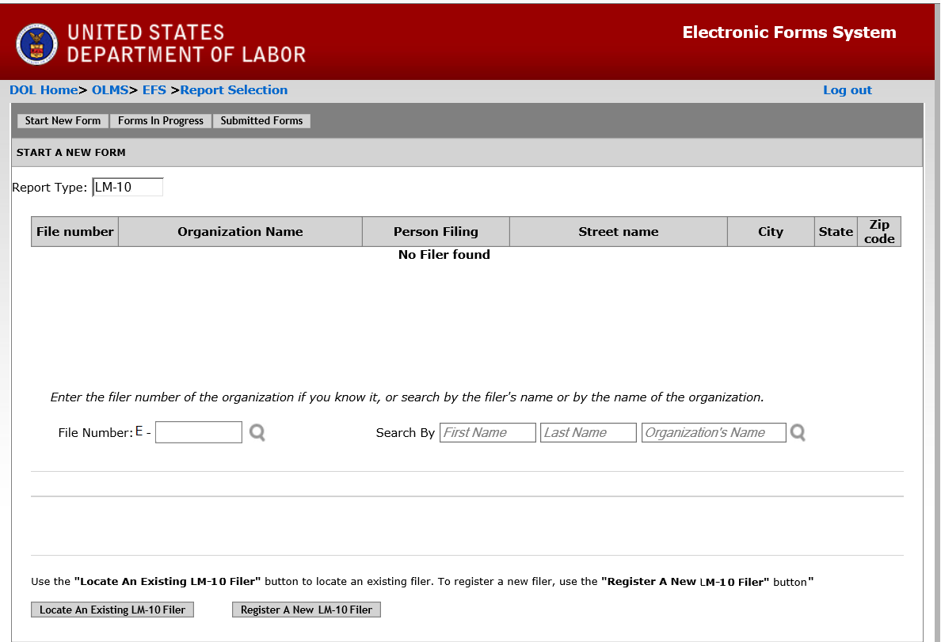
www.olms.dol.gov
Start Form
OLMS - EFS LM 10
EFS will generate a File Number and an Access Key for new organization registered via EFS.
Existing filers will have to generate access key for their organization.

Slide 5
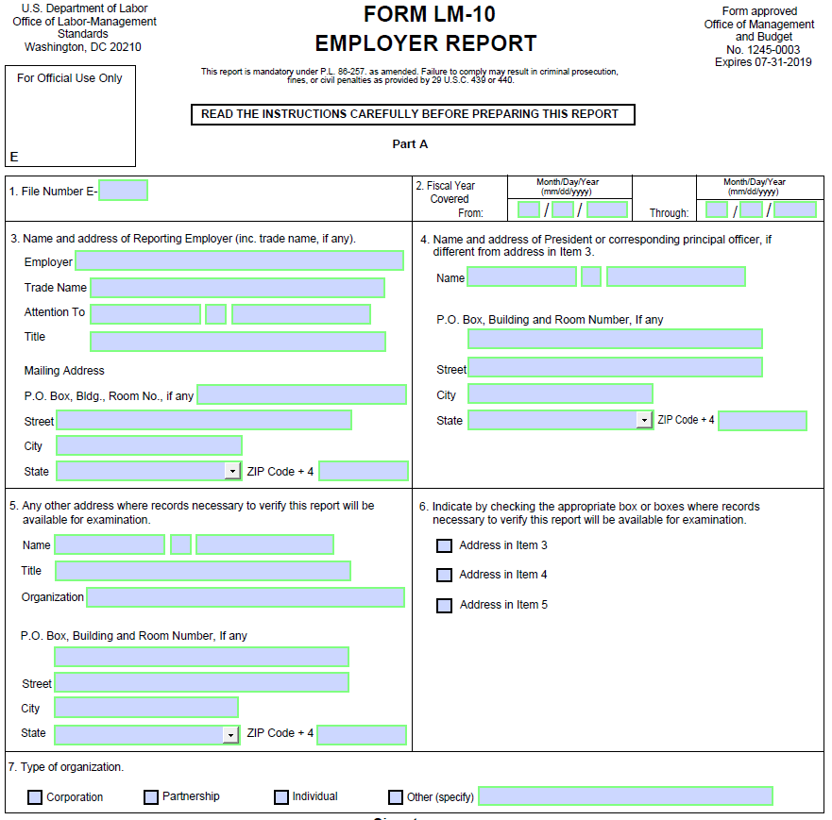
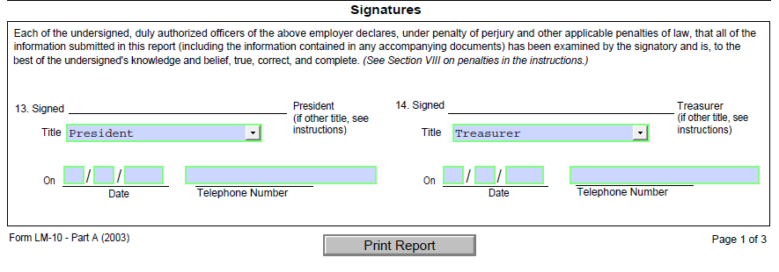
www.olms.dol.gov
Page 1
PDF
OLMS - EFS LM 10

Slide 6
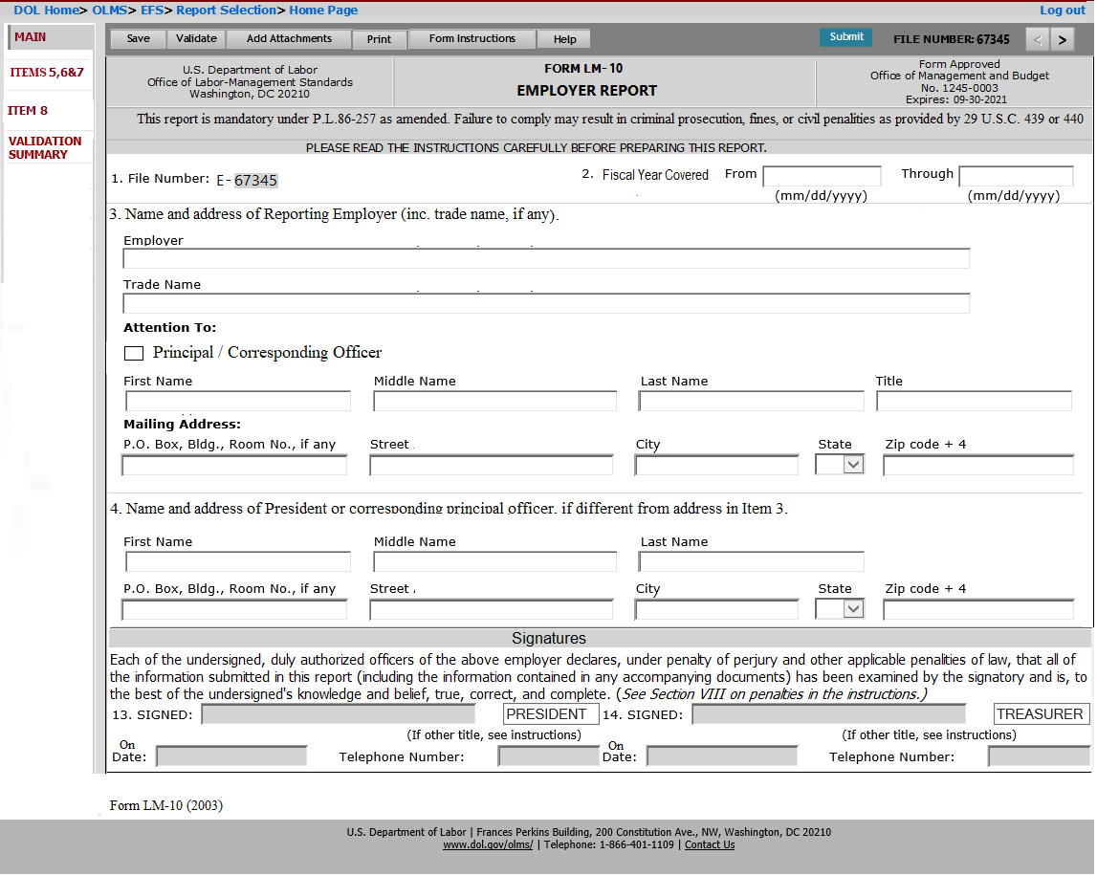
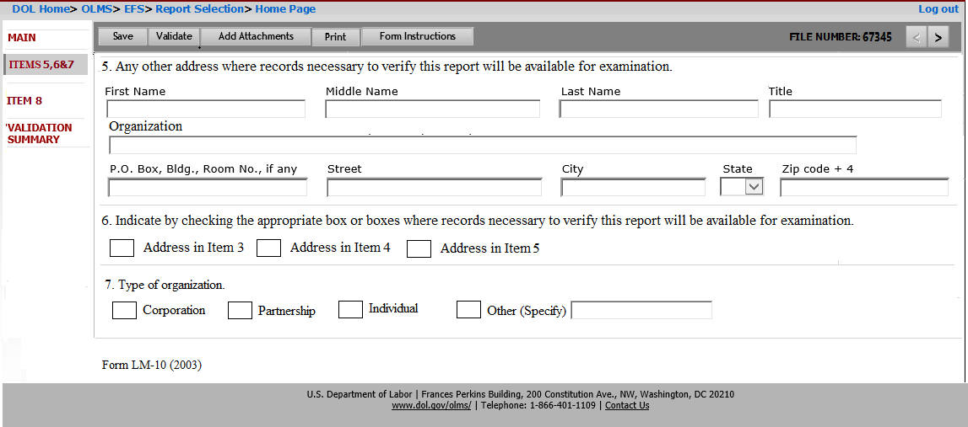
www.olms.dol.gov
Page 1 & 2- Electronic
OLMS - EFS LM 10
Page 1 will list Items 1 to 4 and the signature section.
Page 2 will list Items 5,6 and 7.

Slide 7
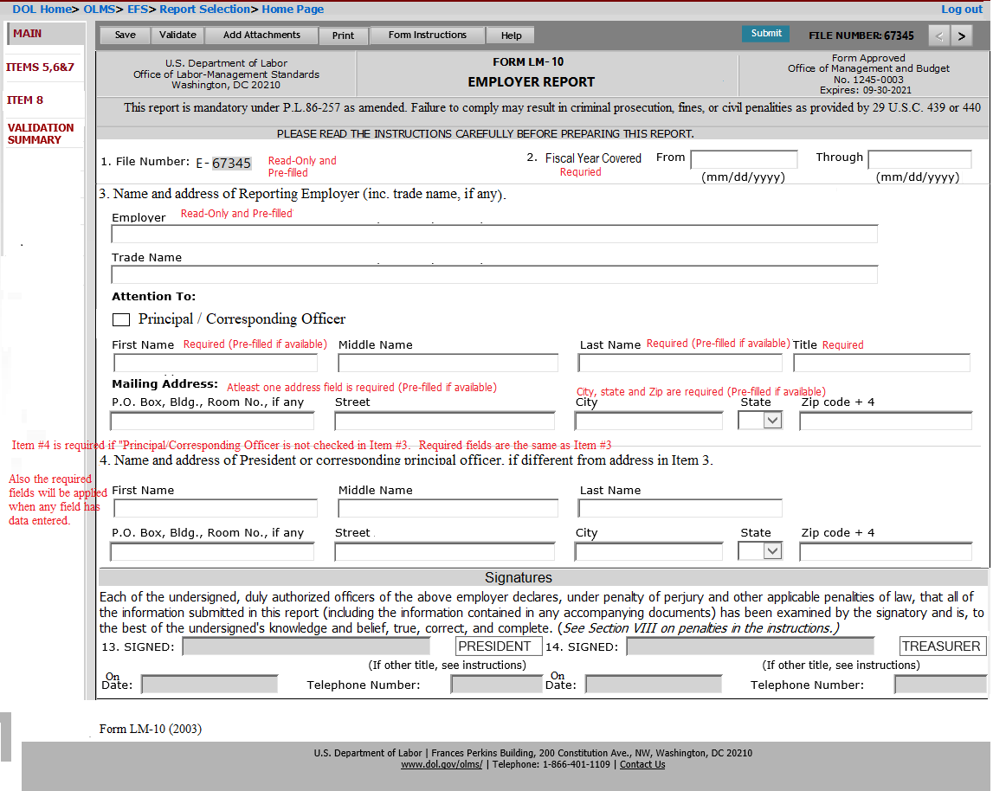
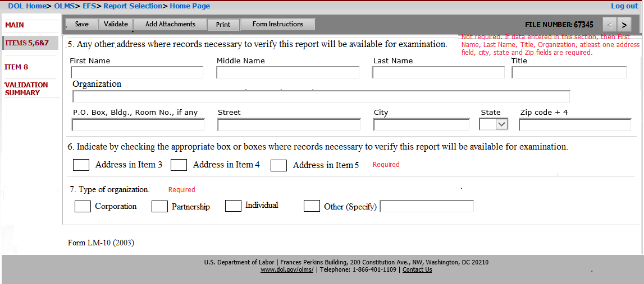
www.olms.dol.gov
Page 1& 2 – Required Fields & Validation Rules
OLMS - EFS LM 10
Item 1 and 3 will be pre-populated.
Employer in Item 3 will display the filer’s organization.
If “Individual” is selected, only one signature will be enabled to sign.

Slide 8
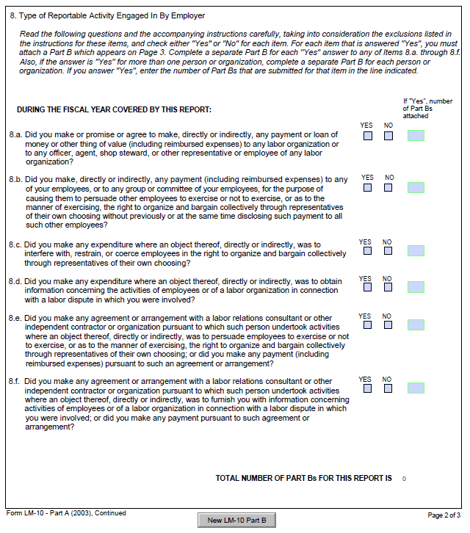
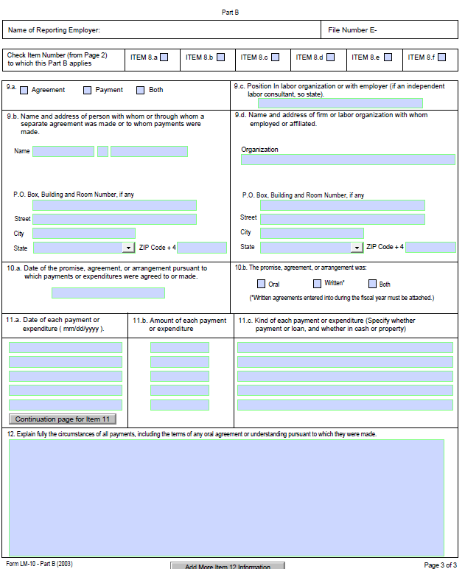
www.olms.dol.gov
Page 2
PDF Part A
PDF Part B
OLMS - EFS LM 10
PDF has Part A and B in two pages.
Also the number of Part B’s getting attached to be identified in Part A.
Electronic form will have Part A and B listed together in one page
Each Part A’s will be listed on separate pages.
Total number of Part B added will be automatically calculated.

Slide 9
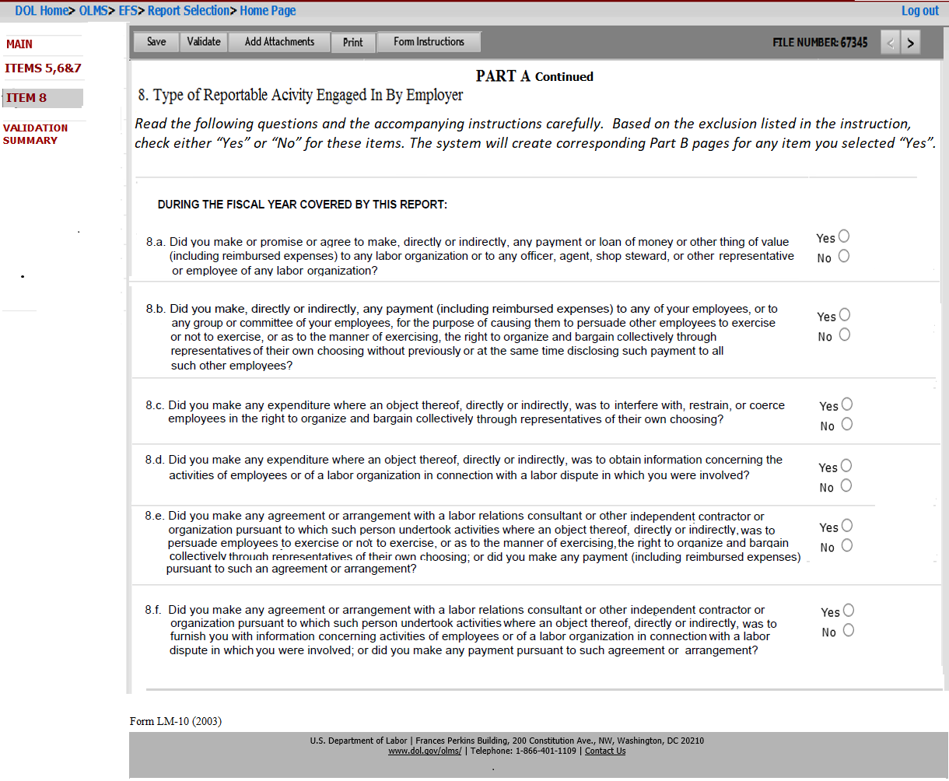
www.olms.dol.gov
ITEM 8
OLMS - EFS LM 10
Questions 8a-8f are required to be answered.
When Saving this page, the system will create seperate Part B pages for each item selected ”Yes”.

Slide 10
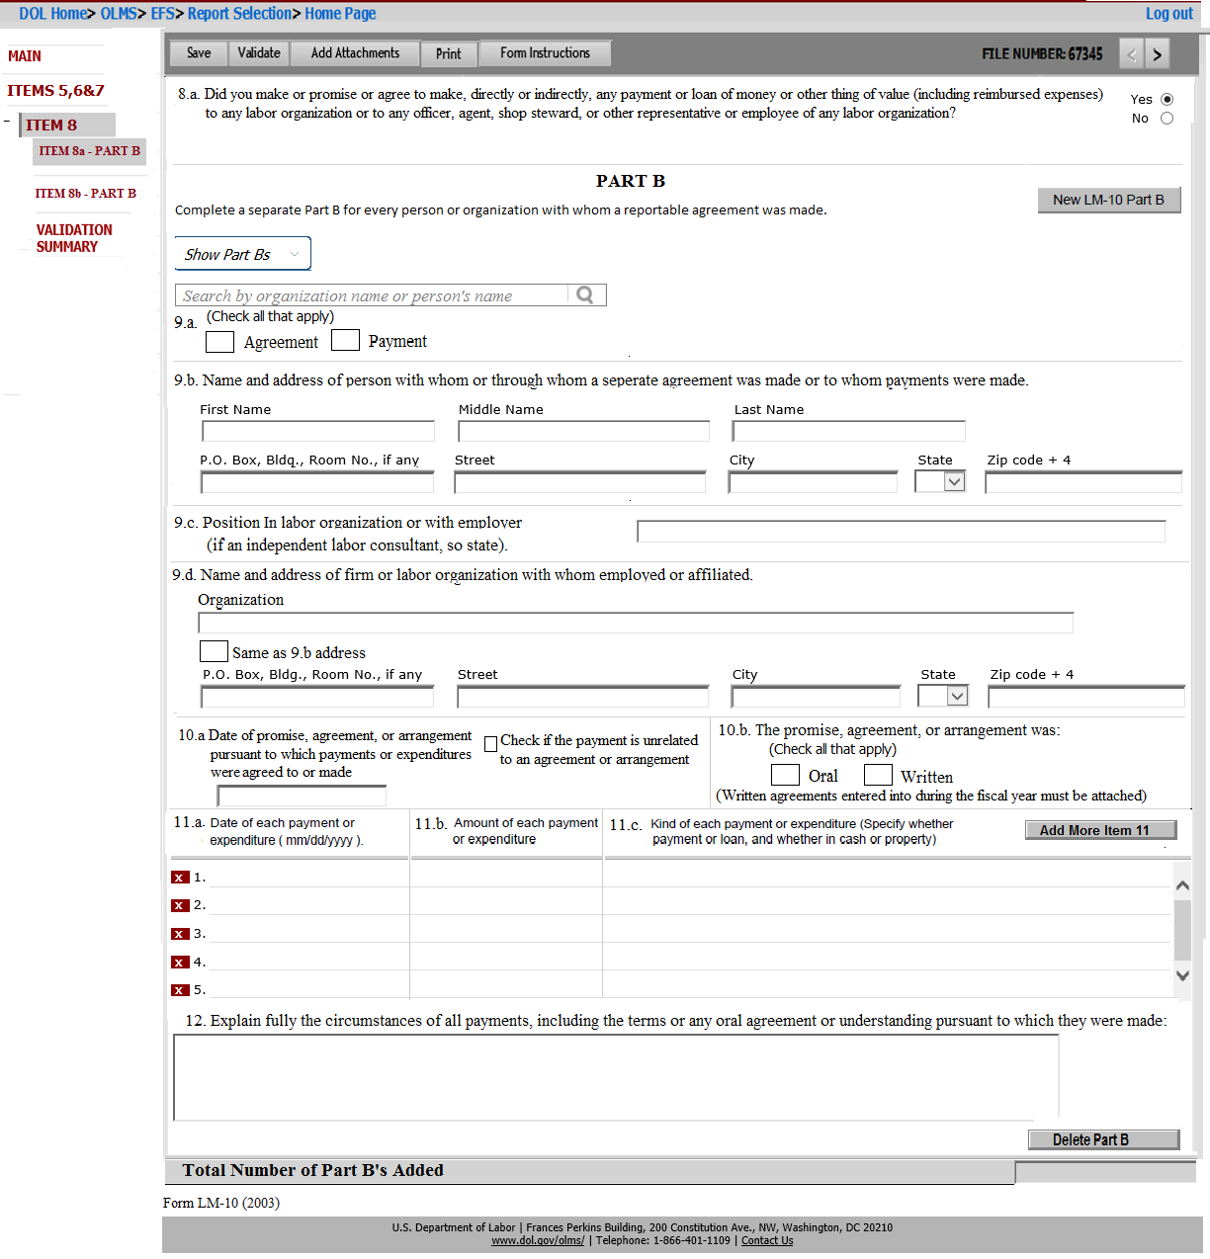
www.olms.dol.gov
Part b
OLMS - EFS LM 10
Corresponding Part A Question will be listed on the top section of this page.
Part A question listed in this page will not be editable
Multiple Part Bs can be added by clicking “New LM-10 Part B” button.
Delete Part B will be available for each Part B.
Each saved Part B will be listed as a drop down list on the header section.
Total number of Part Bs will be calculated during the save and displayed at the bottom of the page.

Slide 11
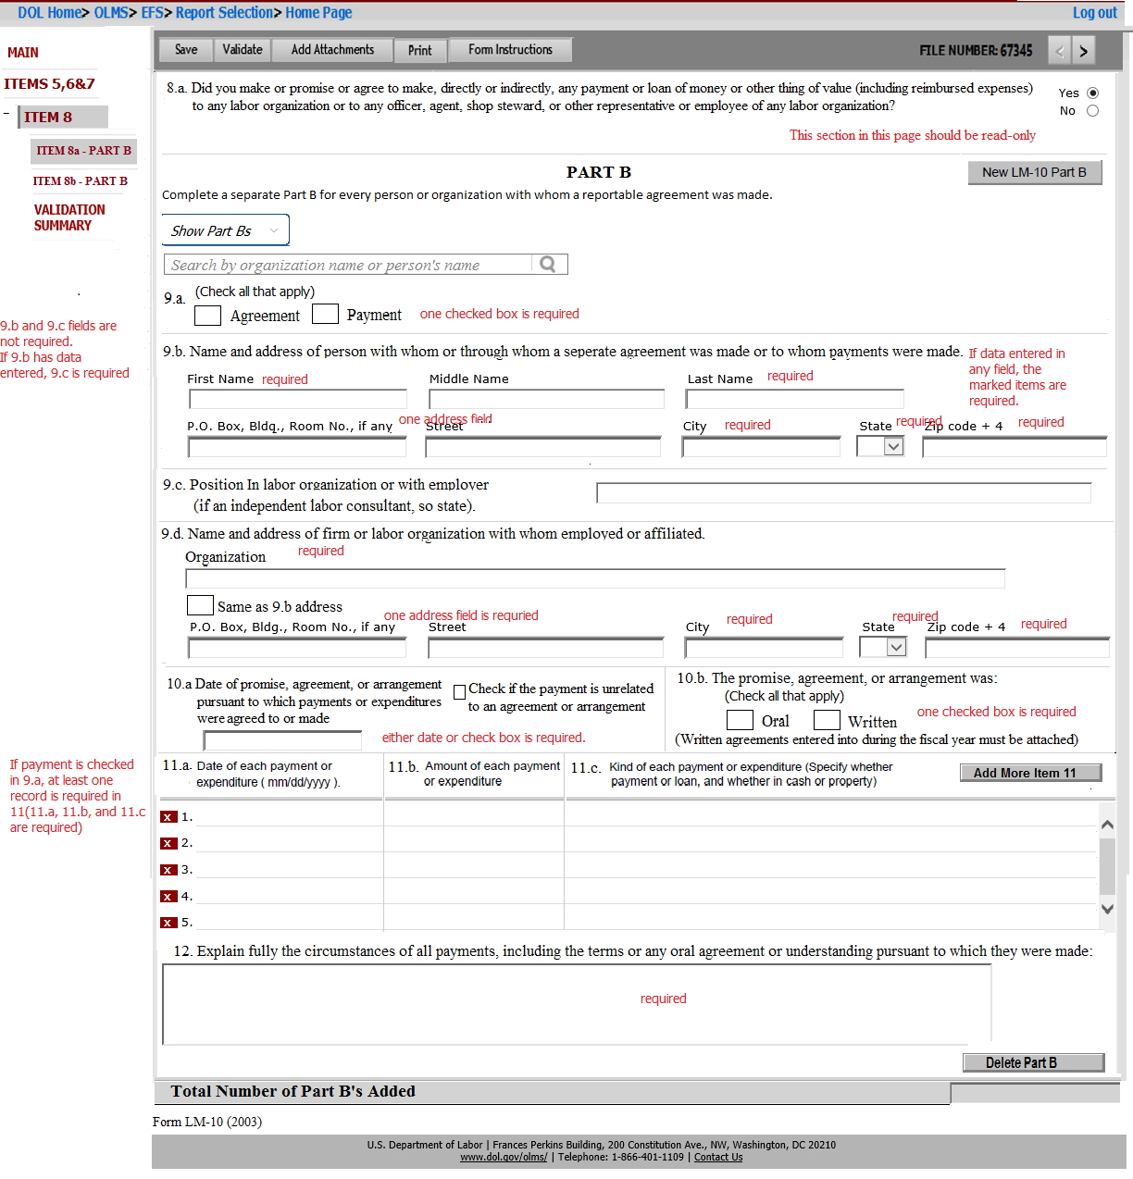
www.olms.dol.gov
Part b – Required Fields
OLMS - EFS LM 10
9.a – One check box must be checked.
9.a and 9.b is not required.
If 9.b has data entered, then 9.c is required.
9.d is required.
10.a is required (date or checking the check box).
10.b – one check box must be checked.
11 is required (at least one item in 11a, 11b and 11c) if Payment is checked in 9.a.
If Agreement is checked, 11 is not required.
12 is required.

Slide 12
www.olms.dol.gov
part b – Search feature
Part b for 8a.
The search feature in Part B for 8a questions should list the data submitted in LM-30s (Item 4 and 5), LM-2s (SCH 11 and 12) and LM-3s (item 24).
LM-30 - Item 4 and 5 - Search result should list First Name, Middle Initial, and Last Name from Item 4 and the organization and title listed from Item 5.
Data mapping will be as follows:
Item 9b will be populated with First Name, Middle Initial, and Last Name from Item 4.
Item 9d will be populated with the labor organization from Item 5.
Item 9d title will be populated with the title of the selected officer/employee from Item 5.
LM-2 - SCH 11 and 12 - Search result should list First Name, Middle Initial, and Last Name from SCH 11/SCH 12, the organization filing LM-2 and title listed in SCH 11/SCH 12.
Data mapping will be as follows
Item 9b will be populated with First Name, Middle Initial, and Last Name from SCH 11/SCH 12.
Item 9d will be populated with the organization filing LM-2.
Item 9d title will be populated with the title of the selected officer/employees from SCH 11/SCH 12.
LM-3 - Item 24 – Search results should list First Name, Middle Initial, Last Name and title from Item 24 and the organization filing LM-4.
Data mapping will be as follows:
Item 9b will be populated with First Name, Middle Initial, and Last Name listed from Item 24
Item 9d - organization will be populated with the organization filing LM-4.
Item 9d title will be populated with the title of the officers from Item 24.
OLMS - EFS LM 10

Slide 13
www.olms.dol.gov
part b – Search feature
Part b for 8e and 8f
The search feature in Part B for 8e and 8f questions should list the data submitted by LM-20/21 filers.
Data mapping from LM-20 will be as follows:
Item 9b First Name, Last Name and Middle Name will be populated with First Name, Last Name and Middle Initial listed in Item 2.
Item 9b-Address will be populated with the address fields listed in Item 2.
Item 9d will be populated with the organization listed in Item 2 and will remain read-only.
Item 9d title will be populated with the title of the filer listed in Item 2.
Data mapping from LM-21 will be as follows:
Item 9b First Name, Last Name and Middle Name will be populated with First Name, Last Name and Middle Initial listed in Item 3.
Item 9b-Address will be populated with the address fields listed in Item 3.
Item 9d will be populated with the organization listed in Item 3 and will remain read-only.
Item 9d title will be populated with the title of the filer listed in Item 3.
OLMS - EFS LM 10

Slide 14
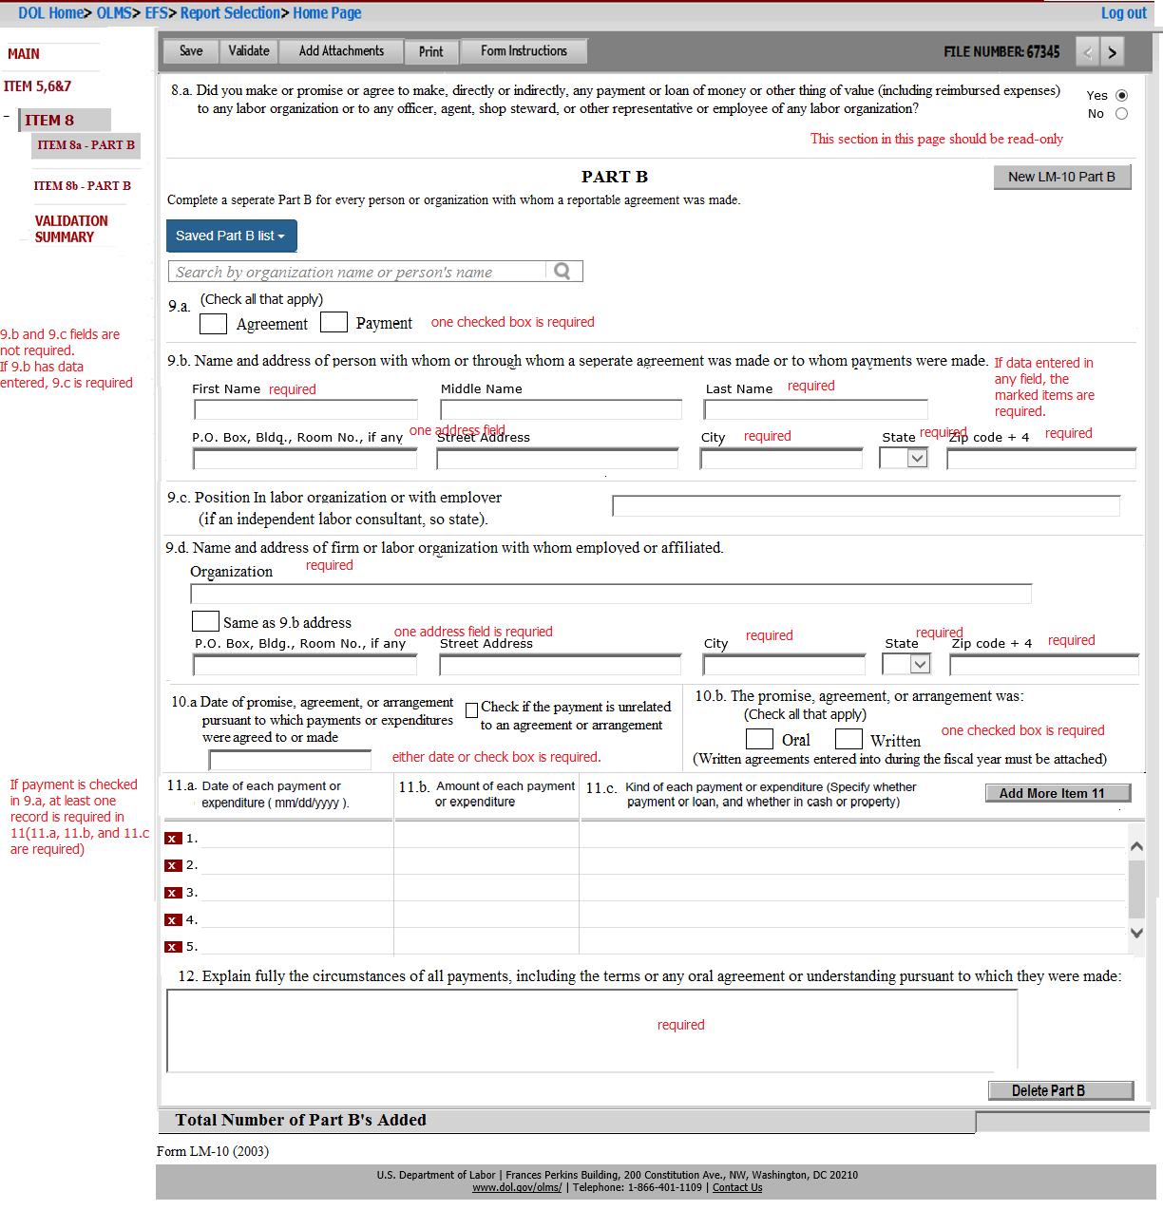
www.olms.dol.gov
Part b – Additional requirements
OLMS - EFS LM 10
PART Bs for 8b, 8c and 8d do not need a search feature.
9.a will have only “Agreement” and “Payment” options.
Disclosure report will match with the approved PDF.
If the address in 9.b and 9.d are same, the filer can check the option “Same address as in 9.b”.
The disclosure report will print the same addresses in both sections.
10.b will have only “Oral” and “Written” options.
Disclosure report will match with the approved PDF.
If Written is checked, an attachment is required.

Slide 15
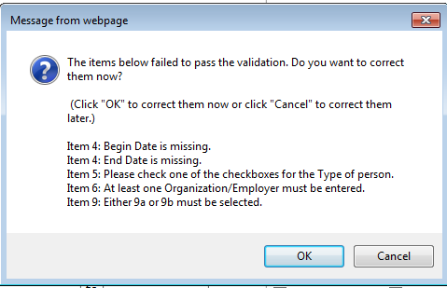
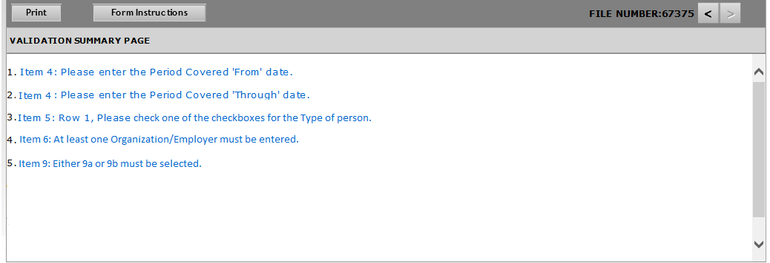
www.olms.dol.gov
Form Validation
To sign and submit, the filer is required to validate the form once the data entry is completed.
Any items failed during the validation will be displayed as a pop-up and in the validation summary page.
OLMS - EFS LM 10

Slide 16
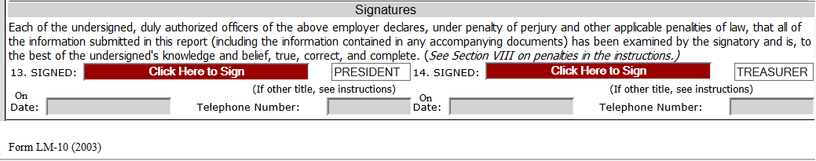
www.olms.dol.gov
Signature
Once the validation of the form is completed and passed, the signature fields will be enabled.
OLMS - EFS LM 10
Item 7 – If Individual option is selected, only Item 13 will be enabled to capture the signature.

Slide 17
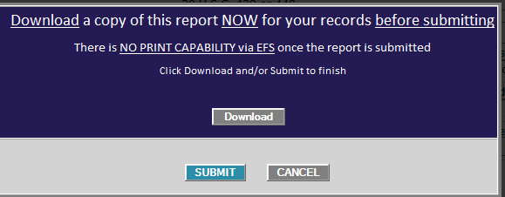
www.olms.dol.gov
Print and Submit
On click of Submit button will have a pop-up option to download the final report or proceed to the submission.
OLMS - EFS LM 10

Slide 18
www.olms.dol.gov
Questions?
OLMS - EFS LM 10

